Slide 1
Notes:
1

Slide 2
Building industry solutions
Tickling the shoulders of giants
An internal client for financial services based on Eclipse RCP
04.11.2011
Holger Grosse-Plankermann
h.grosse-plankermann@iks-gmbh.com
Notes:
Intro: Auf Karten
We chose Eclipse RCP as the base for the client software in a JEE project for a business information provider.
One might say that we stood on the shoulder of the giant called „Eclipse“
We faced a few challenges while implementing this client. I‘d like to talk about some of those.
We tickled this giant a little bit. Did we stand safe on the giants shoulder?
Wer setzt Eclipse RCP schon ein?
Wer plant es einzusetzen?

Slide 3
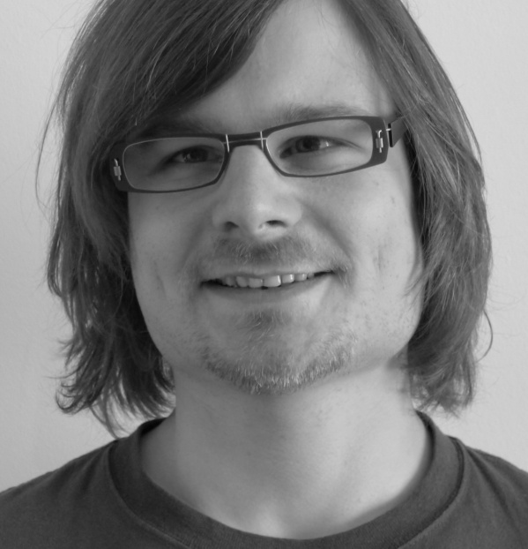
About me
Holger Grosse-Plankermann
Developer @ iks since 2006
Has been implementing Eclipse RCP applications for 4 years
Has published articles about Eclipse RCP
Likes loud guitar tunes and kitchen tools
@holgergp

Slide 4
Challenge Areas
Eclipse RCP Component | Challenge Degree
Eclipse Runtime
SWT
JFace
Workbench
Other prerequisites for the Workbench
Test/Build
Notes:
Übersicht über den technischen Teil des Talks
http://wiki.eclipse.org/RCP_FAQ#What_is_included_in_the_Rich_Client_Platform.3F

Slide 5
Roadmap
Project
Challenges
Review

Slide 6
Project
Form-based Business application
5.000.000 data records
5 Java Developers starting with basic RCP knowledge
Project has been going for 2 1/2 years
Complex problem domain ~ 400 CRs
Notes:
Business Application with complex/large workflows, with the following specifics

Slide 7
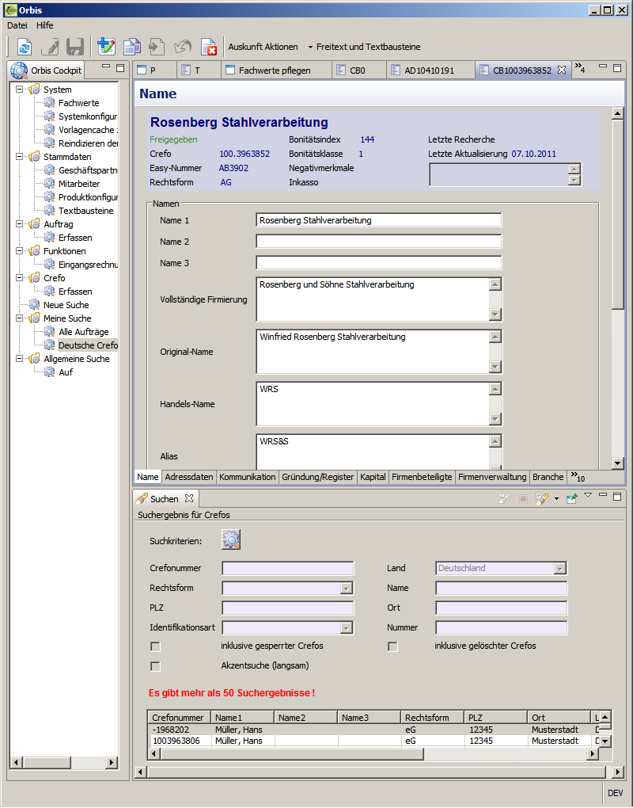
The RCP Client
Eclipse RCP 3.5
Menu View List applications
Editor Area Editors similar
Search View
Notes:
Editors are more or less similar in look an complexity

Slide 8
Parameters
~ 80 screens ~ equally complex
~ 30 UI Elements per screen
~ 20 UI Behaviour Rules per Screen
~ 40 Validation Rules per screen
~ 150 different Validation Rule Types
Notes:
Nicht jede Zahl erwähnen. Nur die wichtigen.

Slide 9
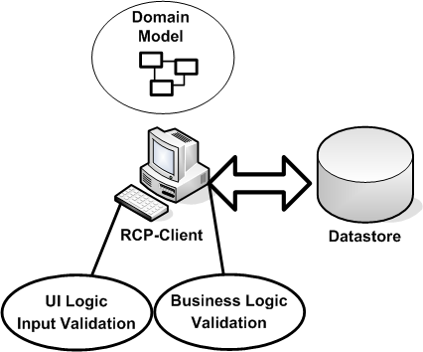
Classic context
Notes:
This is the classic approach to a RCP application.
Not feasible mainly because of security, scalability and already present systems

Slide 10
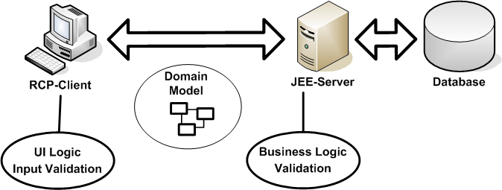
Our context
Notes:
This is our overall architecture:
The most important part on the left side our Eclipse RCP client. It talks via RMI to a JEE Server, which hosts an application that contains our business logic and all our validations. Secondly this JEE part interface to all kinds of additional resources and most importantly the database. The RCP uses almost no local storage.
The RCP client is responsible for the input of the data. Some more or less complex UI logic is needed in that part. To ease up this input the most vital part of the validation is excecuted on input. The data is then validated in its entirely when some operation is triggered that involves a save.
No surprising architecture! Who uses a similar architecture?

Slide 11
Core Challenges
Structuring code of complex screens
Concise definition of numerous UI rules
Considering specifics of distributed Validation
Quality assurance in a complex project

Slide 12
Core Challenges
Structuring code of complex screens
Concise Definition of numerous UI rules
Consider specifics of distributed Validation
Quality assurance in a complex project

Slide 13
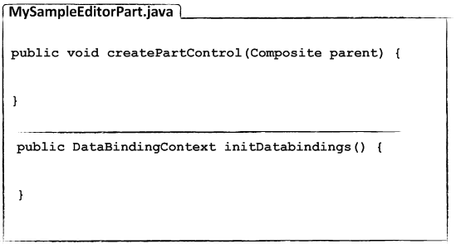
1. UI Code Structure
How to structure the user Interface code
Standard approach:
?
Define Look
Define Behaviour
Notes:
confusing

Slide 14
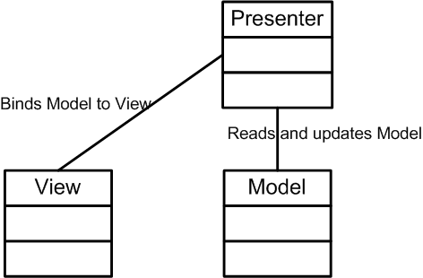
1. UI Code Structure
Separation of concerns: MVP Pattern
Notes:
Split up view and presenter
Vielleicht kurz Unterschied zum MVC erklären

Slide 15
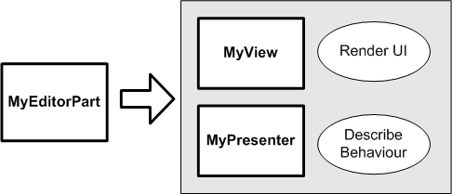
1. UI Code Structure
Split up EditorPart
Notes:
Split up view and presenter
VP => V und P

Slide 16
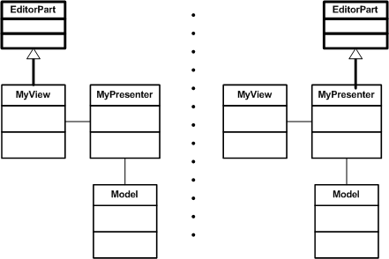
1. UI Code Structure
Which part should extend from the framework :
Notes:
Wording angleichen

Slide 17
1. UI Code Structure
Straightforward approach: View extends from the framework.
Delegate logic to presenter
Easy to implement/refactor
Keeps integration with WindowBuilder
However, too much delegation needed, complex indirection followed.
Notes:
Hartwig: Der View sieht schon so danach aus, also nehmen.

Slide 18
1. UI Code Structure
Presenter extends from the framework.
=> framework supplies lifecycle hooks.
View is a standalone component.
Presenter simply delegates to the createForm method of the view
Workarounds needed to feed view to Window Builder
Special case: Dialogues
Notes:
PassiveView
Welche Presenter Methoden
setFocus
SetActive
setDirty
Save
init

Slide 19
Core Challenges
Structuring code of complex screens
Concise Definition of numerous UI rules
Consider specifics of distributed Validation
Quality assurance in a complex project

Slide 20
2. UI Rules and JFace Databinding
Behaviour Rules:
Behaviour that is triggered when a user keys in a specific value.
Mostly specific to only one Use Case
Commands/Actions too cumbersome in that context

Slide 21
2. UI Rules and JFace Databinding
JFace Databinding for UI State definition Model „single source of truth“
Concise and central definition of bindings
public void initDataBindings() {
binder.bindBeanToText("model.name", view.getTxtName());
}
UI Behaviour Rules should be defined similarly! No out-of-the-box solution available!
Notes:
Domain Model Single Source of truth => Binding läuft dagegen => wir hatten unsere binding logik schon an einem ort (initdb) (deklarativ)=> wir wollten auch die UI Rules in ähnlicher Weise formulieren können => Databinding bietet das nicht => Action
Define behaviour via Databinding
Sehr deklarativer Ansatz, alles in der initDatabinding
StateMachine basierend auf dem Model mit D: GUI Zustand ermittelt sich aus Modell
Übersichtlich
Gut zu generieren aus dem Modell

Slide 22
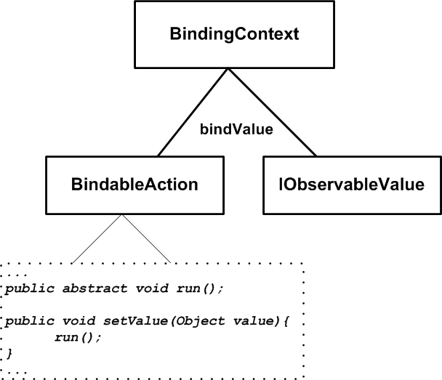
2. UI Rules and JFace Databinding
We implemented a BindableAction

Slide 23
2. UI Rules and JFace Databinding
Complete UI state/behaviour definition in one place in a „declarative“ and clean way
Generation based on model easily possible
public void initDataBindings() {
binder = new BindingUtil(new DataBindingContext(), this);
binder.bindBeanToText("presenter.gp.name1", view.getTxtName1());
binder.bindBeanToCombo("presenter.gp.anredeFachId", view.getCvAnrede());
binder.bindAction(„presenter.gp.lieferantenstatusAktiv", new BindableAction() {
public void run() {
clearTable();
}
);
}

Slide 24
Core Challenges
Structuring code of complex screens
Concise Definition of numerous UI rules
Consider specifics of distributed Validation
Quality assurance in a complex project

Slide 25
3. Validation
 | Client | Backend
Time of validation | On Input | On Save
Amount of validation | Specific input step | Complete Model
Focus of validation | Speed | Complete Validation

Slide 26
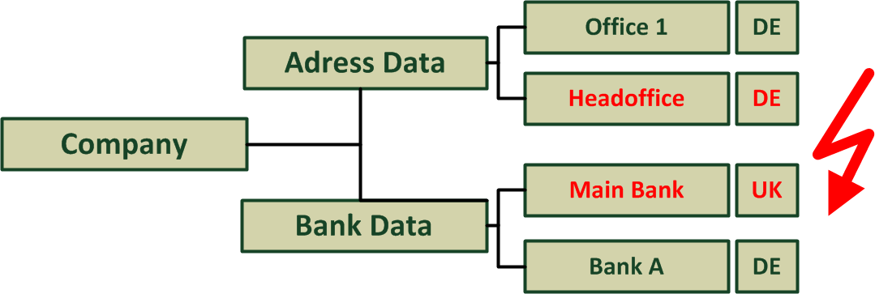
3. Validation
Complex and deep Validation Rules

Slide 27
3. Validation
Validation Rules should be reused on client and backend side. Large intersection between rule types
Validation Rules too complex for JFace Validation alone e.g. Validations across domain model
=> Tie Validation Rules to the model.
Notes:
Nur beide Punkte aufführen
Validierungen sollen wenn möglich nur einmal definiert werden
Intersection
Distributed
Client nur Kontext Validierung
Server komplette Validierung + Zusatzregeln
Wieviele Regeln 120 Regeln
Validierung u.U über mehrere Editoren
Komplexität der Regeln zu komplex für den Einsatz von Eclipse
Zwei Arten der Validierung
Formale Richtigkeit/syntaktisch
Konsistenz/Business Validierung

Slide 28
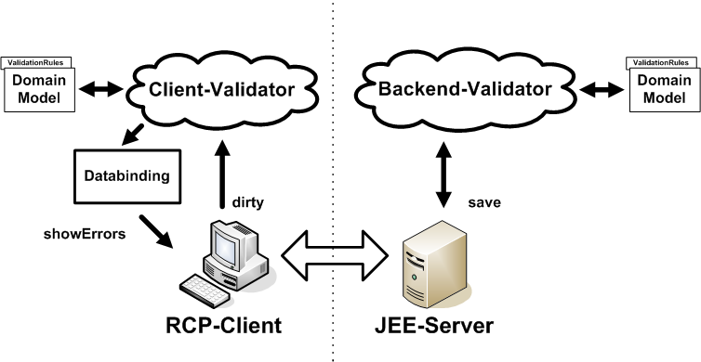
3. Validation
Using custom Validator
Notes:
Similar approach to JSR-303 (Beans Validation)

Slide 29
3. Validation
Validations attached to the model via annotations
public interface IPerson {
@ValidationRules( {
@ValidationRule(classOfRule = NameRule.class, errorCode = "name.invalid", affectedAttributes = "name")
})
void setName(String name);
}
Further steps:
JSR-303 (Beans-Validation)
Notes:
Was passiert bei verschiedenen Validierungsregeln auf einem Modell => JSR 303?

Slide 30
Core Challenges
Structuring code of complex screens
Concise Definition of numerous UI rules
Consider specifics of distributed Validation
Quality assurance in a complex project
Notes:
Knackiger!
Besserer Übergang
All Eclipse RCP Developers in this domain face some kind of common challenge
They need…
We‘ve seen our project has a large domain model, is distributed
Or to stay in the analogy of the giant being tickled. Lets talk about the things we tickeled the giant with. The tickles! ;)
First of all I used to talk a bit about a workflow we needed. We needed some kind of UI equivalent for a workflow.
Secondly
Verteilt
Mehr Übersicht

Slide 31
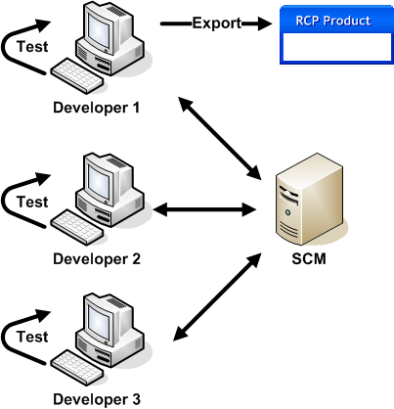
4. Headless Build and Test
The complexity of our project required proper quality assurance measures
Executing SWTBot Test and exporting from workbench grew too tedious

Slide 32
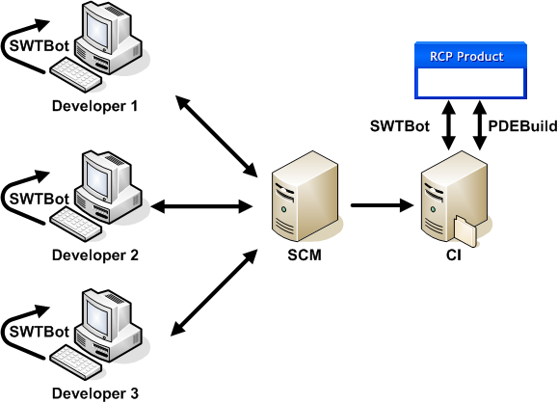
4. Headless Build and Test
Headless build and tests to the rescue!
PDEBuild completed quite quick Days/Weeks
Headless SWTBot more complicated ~ 4 months JUnit3/4 related issues

Slide 33
4. Headless Build and Test
UI Tests tend to be long running Setup UI/Product Wait for UI components to show Complete run (~ 400 tests) takes 30 – 45 mins
UI Tests sometimes behave irregularly Occasional false negatives UI Timing differs between machines Focus related problems

Slide 34
4. Headless Build and Test
Split test suites
Speed up Build Machines
 | Continuous | Regular | Nightly
Duration | ~ 5 mins | ~ 30 mins | ~ 45 mins
# Tests | ~ 50 | ~ 300 | ~ 400
 | Continuous with SSD | Continuous w/o SSD
Duration | ~ 5 mins | ~ 9 mins

Slide 35
4. Headless Build and Test
No satisfying solution for irregular behaviour!
UI timing issues require extra care bot.sleep(2000) mostly helps ☹
Further steps:
Minimize UI related Tests
Apply Controller/Presenter Tests => Eclipse Riena

Slide 36
Core Challenges
Structuring code of complex screens
Concise Definition of numerous UI rules
Consider specifics of distributed Validation
Quality assurance in a complex project

Slide 37
Safe on the shoulders of giants?
 | Expectations | Experiences
Learning
Out-of-the-box
Requirements
Eclipse RCP + Customizing
Notes:
Augumented Eclipse, viel von EclipseWay lernen
Bottom line:
Würden wir es wieder einsetzen? War es die richtige Entscheidung? Ja!
To give you a little bit more detail about our experiences, I try to compare our expectations to our perception:
Eclipse RCP is harder than we expected.
It is as sound and flexible as we expected, that is why learning it is that hard.
Our requirements were realizable using Eclipse RCP!
Besides coding we wanted decent test-coverage, CI integration and so on. We did, but it was ridiculously hard!
Eclipse RCP does many things right and great, but for a business application like ours we had to go some extra miles.
Additional Frameworks on top of Eclipse RCP can help.
Eclipse RCP was a good choice for our project conditions. Though we sometimes missed some more support by the core framework. You still feel heritage of an IDE base now and then.
Lack of best practices/patterns Feels kind of young

Slide 38
www.iks-gmbh.com

Slide 39
Image Sources
Roadmap: http://www.flickr.com/photos/scoobay/3788514070/
Mixing desk: http://www.flickr.com/photos/go_freyer/4486482108/
Check: http://commons.wikimedia.org/wiki/File:Green_check.svg
X-Mark: http://commons.wikimedia.org/wiki/File:X_mark.svg
Feather: http://www.flickr.com/photos/n0rthw1nd/4418311590/
Plain face: http://commons.wikimedia.org/wiki/File:Face-plain.svg
Sad face: http://commons.wikimedia.org/wiki/File:Face-sad.svg
Happy face: http://commons.wikimedia.org/wiki/File:Face-smile.svg
Light Bulb and Warning Icons via Creative Commons Attribution 3.0 Unported by
http://shlyapnikova.deviantart.com

